Slide 1

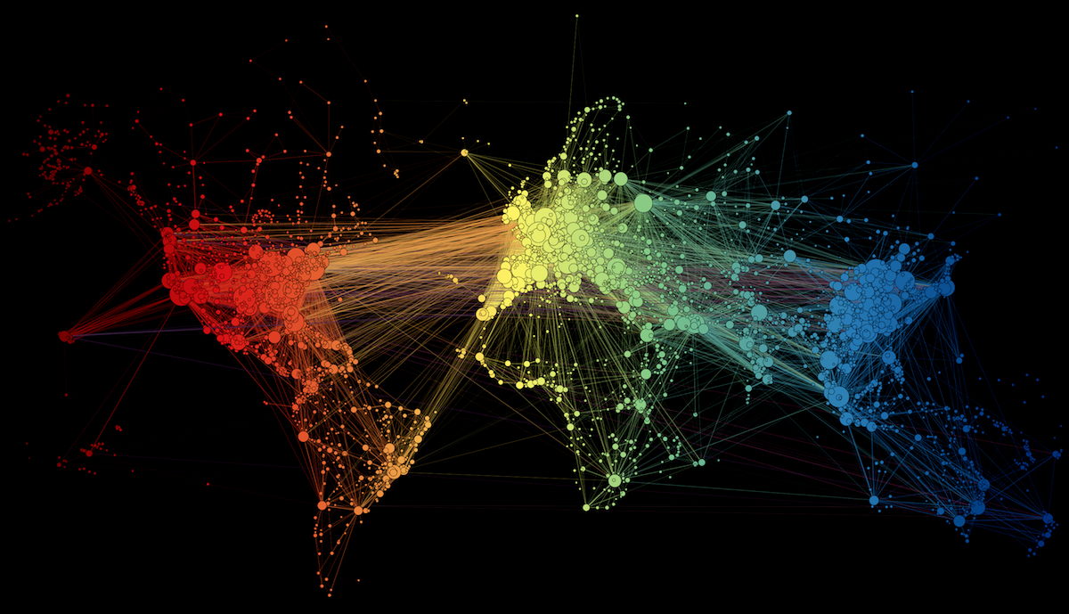
NETWORK VISUALIZATION
Jarai carter
Informatics phd student
Is590: data visualization 3-12-18

Slide 2
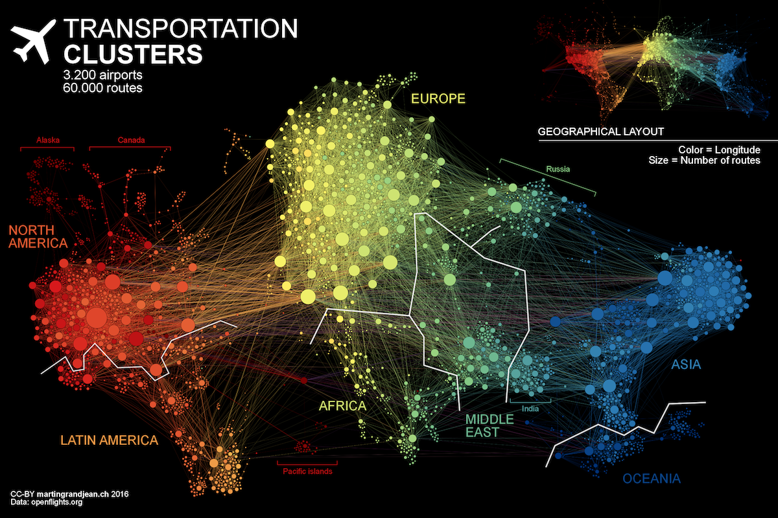
http://www.martingrandjean.ch/connected-world-air-traffic-network/

Slide 3
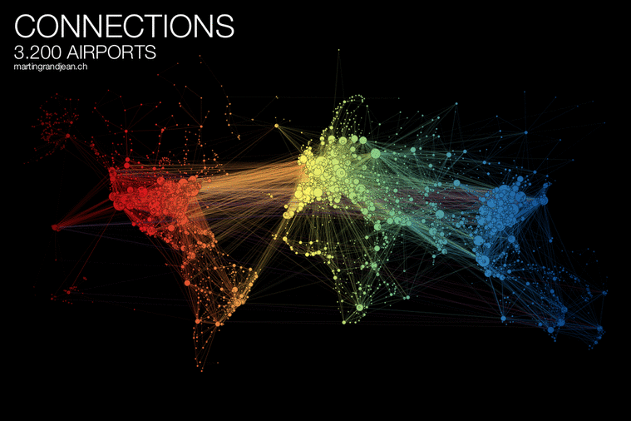
http://www.martingrandjean.ch/connected-world-air-traffic-network/
Notes:
Animated GIF of airport network visualization

Slide 4


INSTALLING R AND RSTUDIO
https://cran.r-project.org/
https://www.rstudio.com/products/rstudio/download/#download
https://www.r-project.org/logo/Rlogo.png
https://www.rstudio.com/wp-content/uploads/2014/07/RStudio-Logo-Blue-Gradient.png
Notes:
Have everyone install R first, then R studio, get files downloaded from slack and/or Moodle

Slide 5
NETWORK BASICS
Node (vertex, actors): points in the network
Edge (links, ties): connections in the network
Degree: how many links a node has
Density: ratio of actual links to possible links
Person 1
Person 2
Person 3
undirected
Person 4
directed
Notes:
The bare minimum basics you need to know to make these visualizations today. Network analysis is based off of graph theory.

Slide 6
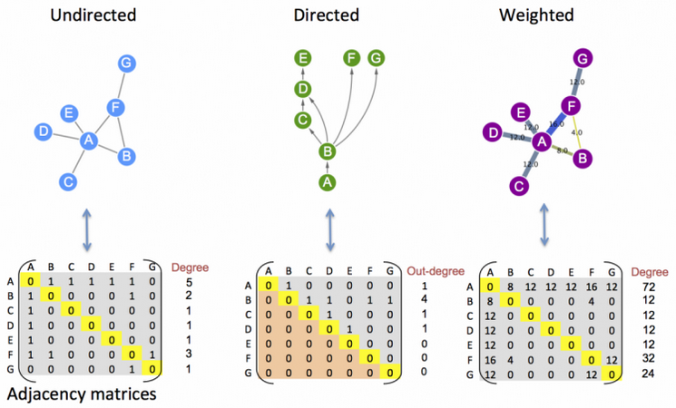
NETWORKS ARE MATRICES
https://www.ebi.ac.uk/training/online/course/network-analysis-protein-interaction-data-introduction/introduction-graph-theory/graph-0

Slide 7
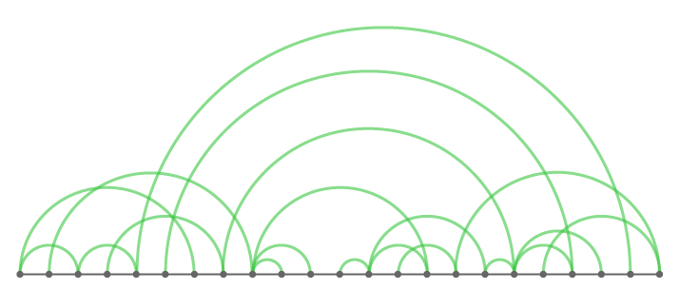
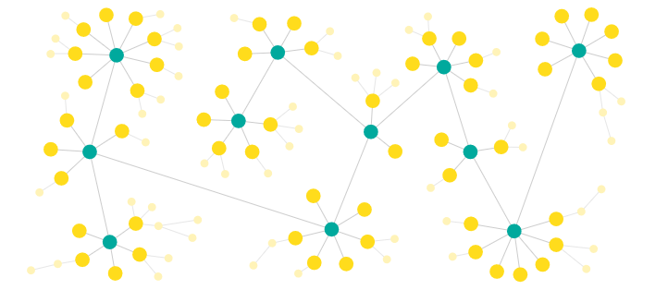
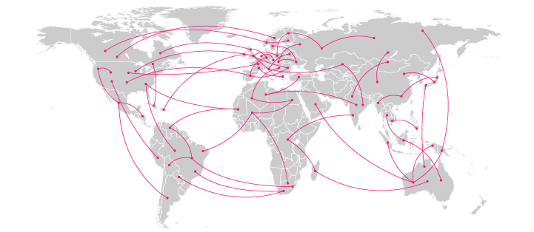
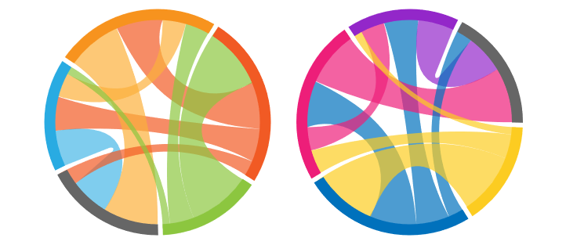
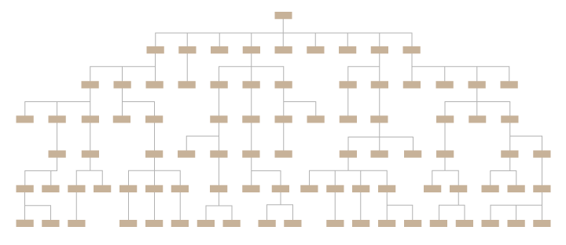
TYPES OF NETWORKS
Arc diagrams
Basic network diagrams
Connection maps
Chord diagrams
Tree diagrams
https://datavizcatalogue.com/

Slide 8
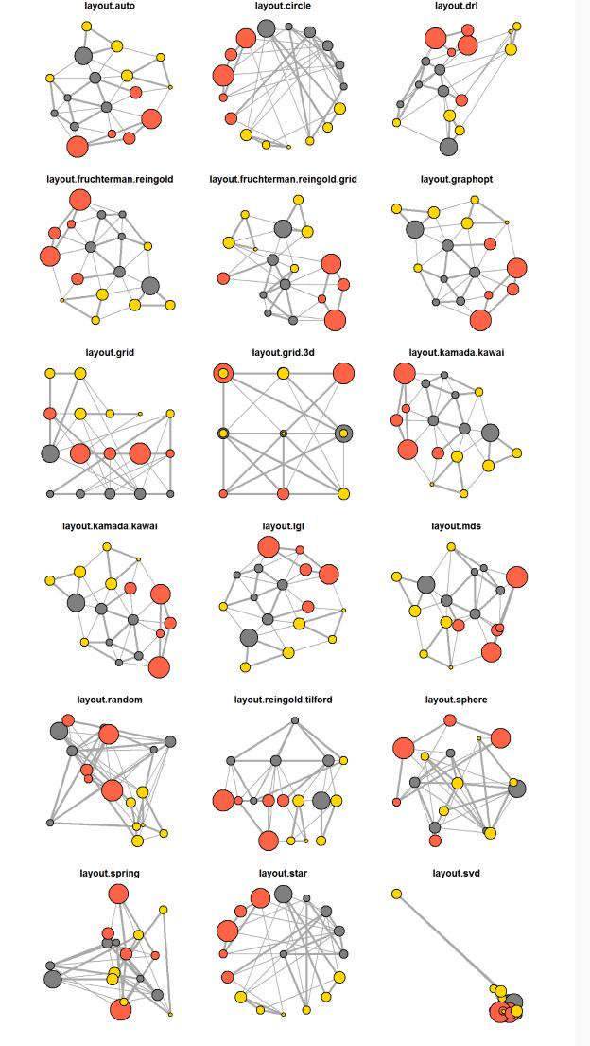
NETWORK LAYOUTS
http://kateto.net/network-visualization

Slide 9
MORE NETWORK TOOLS
Cytoscape (http://www.cytoscape.org/)
Gephi (https://gephi.org/)
NodeXL (https://www.smrfoundation.org/nodexl/)
D3.JS (https://d3js.org/)
Plotly and NetworkX (https://plot.ly/python/network-graphs/)
Vega (https://vega.github.io/editor/#/)

Slide 10
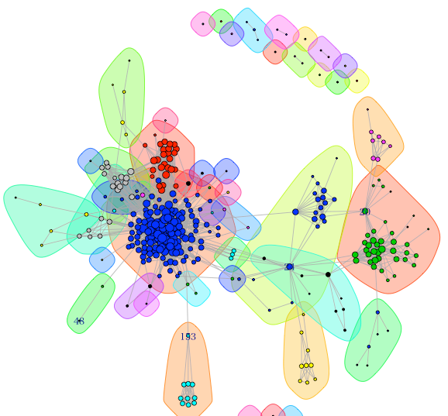
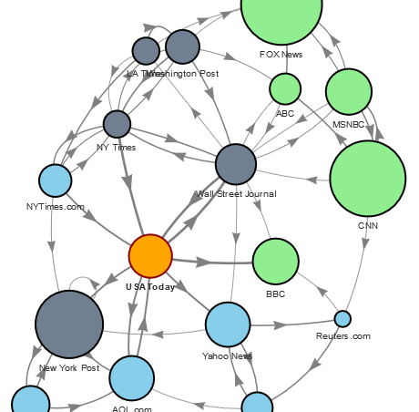
NETWORKS WE WILL BUILD!
STATIC
INTERACTIVE
http://rstudio-pubs-static.s3.amazonaws.com/16964_51e7279958474bb5b1c1560cb49237a7.html
http://willgeary.github.io/data/2017/02/07/Visualizing-Networks.html
Notes:
Both made with R, visit the interactive network website on the left and static network website on the right

Slide 11
TIME TO MAKE SOME NETWORKS
Notes:
Overview of R Studio
Create static network
Save plot
BREAK
Create interactive network
Save plot
Talk about resources available for them to use

